Slide 1
Early Kings
The period of the first kings of Israel, Saul, David and Solomon
Highland dwellers unite from the confederations or tribal organizations of the biblical period of judges into a monarchy
Begins with the Iron Age
Ends with the division of Solomon’s kingdom into Israel and Judah
Click to download color PDF

Slide 2
Pool of Gibeon 11th Century BC
2 Samuel 2:13
“And Jo'ab the son of Zeru'iah, and the servants of David, went out and met them at the pool of Gibeon…”
Jar handles inscribed with the word “Gibeon” were found in the debris of the water shaft. Written from right to left in 7th century B.C. Hebrew script, many of the inscriptions on the handles have next to the word “Gibeon” the phrase, “the enclosed vineyard” and the name of the owner of the vineyard. The discovery of an extensive wine production and storage complex at Gibeon confirmed that the Gibeonites stored wine in the jars to which the inscribed handles were once attached.
Biblical Archaeology Review 6:2, March/April 1980
How Water Tunnels Worked
Biblical Archaeology Review 21:3, May/June 1995
10 Great Finds

Slide 3
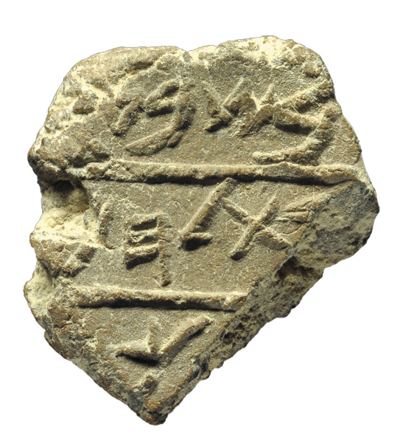
Bethlehem Seal Impression 7th Century BC
A bulla containing for the first time in any ancient archaeological context the name of the city of Bethlehem
1 Samuel 17:58
"Whose son are you, young man?" Saul asked him. David said, "I am the son of your servant Jesse of Bethlehem."
Biblical Archaeology Review 38:5, September/October 2012
Strata: “Bethlehem” from IAA Dig Found by Archaeologist IAA Arrested

Slide 4
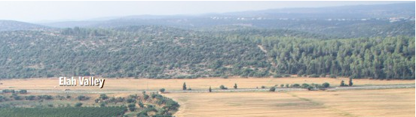
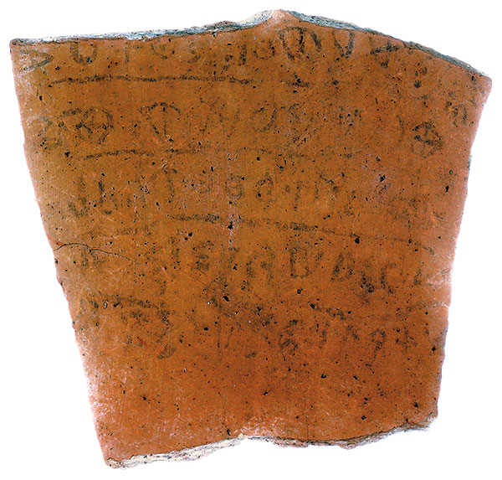
King Saul at Elah Valley?
1 Samuel 13:1, 17:2
And Saul and the men of Israel were gathered, and encamped in the Valley of Elah, and drew up in line of battle against the Philistines."
“Saul was thirty years old when he began to reign, and he reigned forty two years over Israel. …
Biblical Archaeology Review 43:1, January/February 2017
Rejected! Qeiyafa’s Unlikely Second Gate
Tel Qeiyafa Inscription
“The men and the chiefs/officers have established a king” [Most likely Saul]
Biblical Archaeology Review 38:3, May/June 2012
Ancient Inscription Refers to Birth of Israelite Monarchy

Slide 5
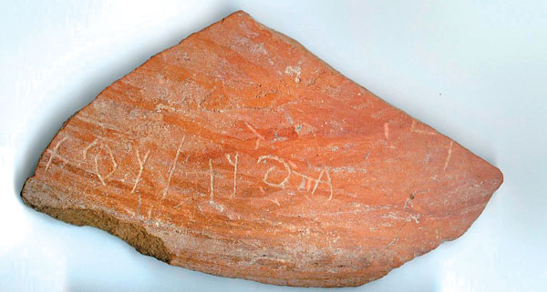
“Goliath” Inscribed on Philistine Pottery 1000-850 BC
1 Samuel 17:4
"A champion named Goliath, who was from Gath, came out of the Philistine camp. His height was six cubits and a span."
Biblical Archaeology Review 32:2, March/April 2006
Strata: New Finds
Two names scratched onto a small sherd of pottery are all that appear in the oldest Philistine inscription ever found. Though the names are Philistine—the one on the right may be the equivalent of Goliath—the letters themselves are Semitic, thus demonstrating that the Philistines (a sea-faring people from the Aegean) absorbed aspects of Semitic culture once they settled on the coast of modern Israel.

Slide 6
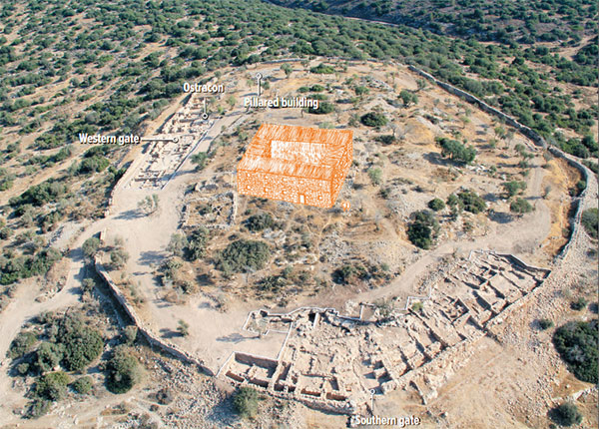
Khirbet Qeiyafa Fortress
What was the ancient name of Khirbet Qeiyafa? We suggest that it was the Biblical site of Sha’arayim, mentioned twice as located in the Valley of Elah, twice connected with David and specifically as part of the David and Goliath story in 1 Samuel 17:52. The name Sha’arayim means “two gates,” and indeed Khirbet Qeiyafa had two gates, a phenomenon not found in any other small city of this period.
Biblical Archaeology Review 39:6, November/December 2013
An Ending and a Beginning

Slide 7
The Eshtemoa Silver Hoard 10th-8th Century BC
1 Samuel 30:26-28
“When David reached Ziklag, he sent some of the spoil to the elders of Judah [and] to his friends, saying, ‘This is a present for you from our spoil of the enemies of the Lord.’ [He sent the spoil to the elders] in Bethel, Ramoth-negeb, and Jattir; in Aroer, Siphmoth, and Eshtemoa … all the places where David and his men had roamed”
The style of the script and the shape of the vessels date the jars to the late 10th–8th centuries B.C.—after the reign of David.
Biblical Archaeology Review 13:6, November/December 1987
The Mysterious Silver Hoard from Eshtemoa

Slide 8
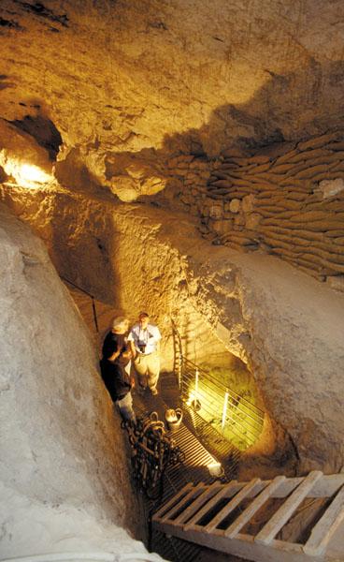
Jebusite Water Shaft Discovered in the City of David in 1867
2 Samuel 5:7-8
“Nevertheless, David captured the fortress of Zion—which is the City of David. On that day David had said, “Anyone who conquers the Jebusites will have to use the water shaft to reach those ‘lame and blind’ who are David’s enemies. ”
That Warren’s Shaft—named for the British explorer and engineer who discovered it in 1867—is the much-disputed tsinnor was a viable suggestion until the studies conducted by the late Yigal Shiloh in the 1980s proved otherwise. Shiloh concluded—after which it was generally accepted—that the Warren’s Shaft system was not created until the time of the Divided Monarchy, in Iron Age II, long after David’s conquest of the city.
Biblical Archaeology Review 29:5, September/October 2003
Warren’s Shaft

Slide 9
Head of an Ammonite King
2 Samuel 12:30
“And he took the crown of their (the Ammonites) king from his head; the weight of it was a talent of gold, and in it was a precious stone; and it was placed on David's head.”
The limestone head, bearing a crown, is said to have been unearthed in the vicinity of Amman, a name which even today preserves its Ammonite origin. The Ammonites lived east of the Jordan during the Israelite Monarchy and often came into conflict with the Israelite.
Biblical Archaeology Review 8:5, September/October 1982
The Dayan Saga—The Man and His Archaeological Collection

Slide 10
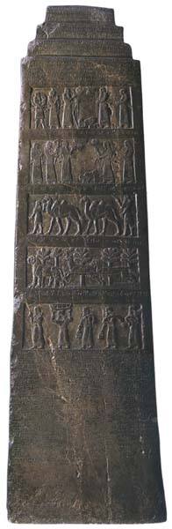
Hazael, King of Aram 848–805 BC
1 Kings 19:15
“The Lord said to him [Prophet Elisha], ‘Go back the way you came, and go to the Desert of Damascus. When you get there, anoint Hazael king over Aram.’”
The Black Obelisk of Shalmaneser III
“I crossed the Euphrates for the twenty-first time. I marched aginst the towns of Hazael of Damascus.”
Hazael
Public Domain - Art
Biblical Archaeology Review 21:1, January/February 1995
Did King Jehu Kill His Own Family?

Slide 11
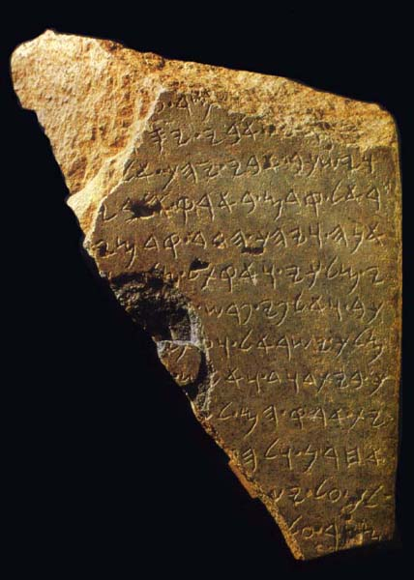
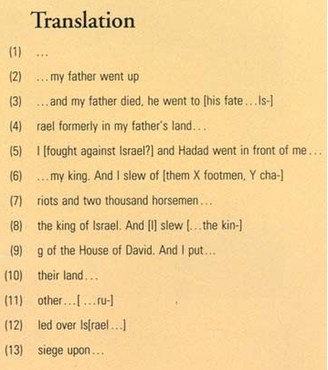
The Tel Dan Stele
Biblical Archaeology Review 20:2, March/April 1994
“David” Found at Dan
See also:
Biblical Archaeology Review 20:4, July/August 1994
“House of David” Built on Sand: The Sins of the Biblical Maximizers
Biblical Archaeology Review 20:6, November/December 1994
The “House of David” and the House of the Deconstructionists

Slide 12
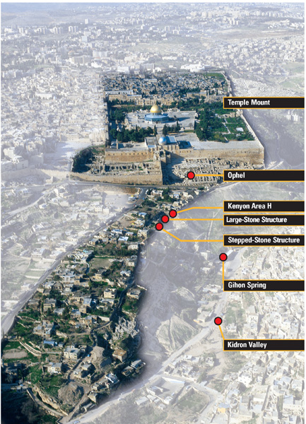
King David’s Palace?
“David went down to the fortress” when he feared an attack by the Philistines, according to 2 Samuel 5:17. Where did he go down from? Author Eilat Mazar suggests that the Stepped-Stone Structure was part of the same complex as David’s palace. Her suggestion may seem odd at first—why would David have built his royal residence beyond Jerusalem’s fortified walls? Because there was no room within the small walled city, Mazar answers. The palace required no protection in normal times; when a threat loomed, David and his entourage could quickly “go down,” as the Bible says, to the city’s fortress a few feet to the south.
Biblical Archaeology Review 32:1, January/February 2006
Did I Find King David’s Palace?

Slide 13
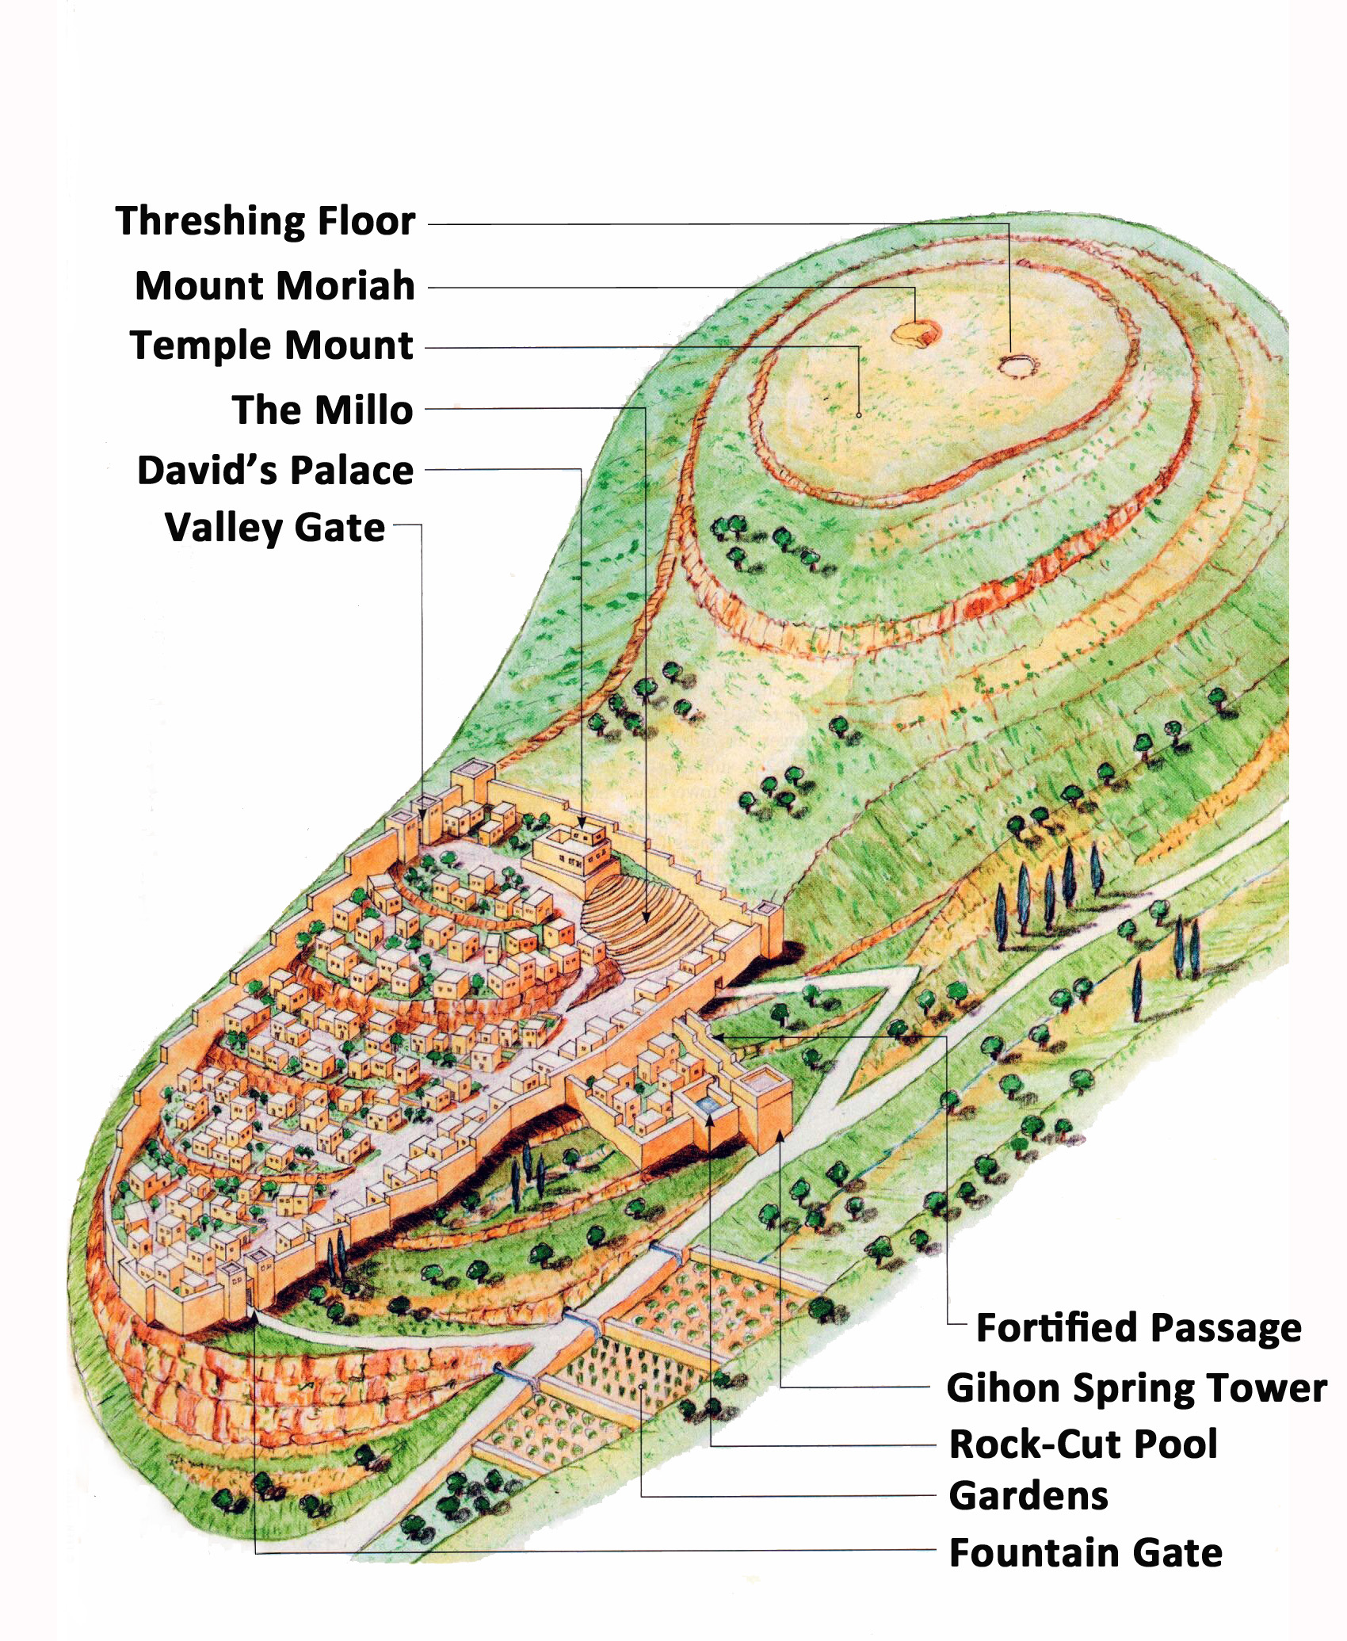
Attention on the Temple Mount
2 Samuel 24:18, 25
“’Go up, erect an altar to the LORD on the threshing floor of Araunah the Jebusite.’ …
David built there an altar to the LORD and offered burnt offerings and peace offerings. Thus the LORD was moved by prayer for the land, and the plague was held back from Israel.”
Biblical Archaeology Review 40:1, January/February 2014
The Interchange Between Bible and Archaeology

Slide 14
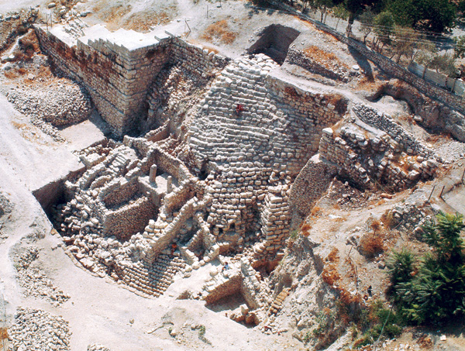
The Millo
In Eilat Mazar’s second season of excavation, she demonstrated that the broad eastern wall of her Large Stone Structure (W20) was in fact connected to the Stepped Stone Structure in Shiloh’s Area G. Since the Stepped Stone Structure had been dated to the Iron Age I, this further solidified the date of the Large Stone Structure’s original construction to the same period.
Biblical Archaeology Review 38:5, September/October 2012
Did Eilat Mazar Find David’s Palace?
2 Samuel 5:9
“So David lived in the stronghold and called it the city of David. And David built all around from the Millo and inward.”

Slide 15
Figure from the Ancient Hittite Capital Found in Central Anatolia
2 Samuel 11:6
“So David sent this word to Joab: ‘Send me Uriah the Hittite.’”
Dressed in a Hittite warrior’s costume, this figure carved on the King’s Gate door-jamb of the southeastern entrance to ancient Håattusûas (Bogûazko¬y, Anatolia) wears a belted short kilt, helmet with ear-pieces, and plume. He also carries a sword with a crescent-shaped handle and a hand-shaped battle axe. A similar axe and sword have been found in Palestine and in the Persian site of Luristan. The door-jamb dates to the fourteenth century B.C.
Biblical Archaeology Review 5:5, September/October 1979
Hittites in the Bible: What Does Archaeology Say?

Slide 16
Bronze cymbals c. 14th century BC, Found at Tall al-‘Umayri
2 Samuel 6:5
“And David and all the house of Israel were making merry before the LORD with all their might, with songs and lyres and harps and tambourines and castanets and cymbals.”
Cymbals, each about 4 inches in diameter, found in Building A at ‘Umayri. 1 Samuel 10:5 describes a band of prophets playing musical instruments, perhaps including cymbals like the ones shown here.
Biblical Archaeology Review 27:2, March/April 2001
Excavating the Tribe of Reuben

Slide 17
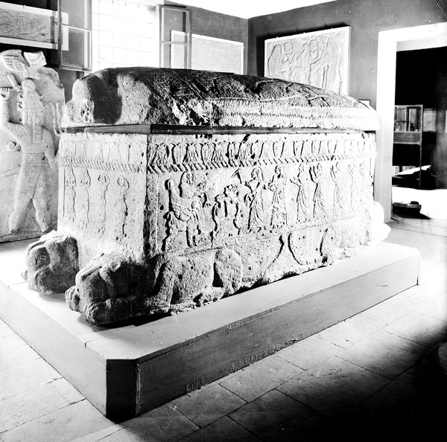
Sarcophagus of Ahiram, Phoenician King of Byblos
1 Kings 5:18
“The craftsmen of Solomon and Hiram and workers from Byblos cut and prepared the timber and stone for the building of the temple.”
Reclining lions support the four corners of the 11th-century B.C.E. stone sarcophagus of King Ahiram of Byblos, now in the Beirut Museum. Reliefs on the side panels depict a funerary banquet in which attendants stack cups and dishes on the offering table before the king who sits at left, enthroned on sphinxes.
Biblical Archaeology Review 38:6, November/December 2012
Is T1 David’s Tomb?

Slide 18
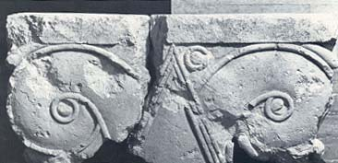
Elaborate Construction
1 Kings 7:19
“The capitals at the tops of the pillars in the [Temple] vestibule were shaped like lilies and were four cubits high.”
Biblical Archaeology Review 23:1, January/February 1997
Excavate King David’s Palace!
Given the sophisticated craftsmanship of the capital and its bulk (4 feet long, 2 feet high, 1.5 feet thick), the building it adorned must have been impressive. Did it rest over the entranceway to David’s palace? Although archaeologist Yigael Shiloh dated the stones and capital to the ninth century B.C.E., author Eilat Mazar observes that there is no reason they could not date a century earlier (to the time of David). Or, if they do date to the ninth century, Mazar suggests, they could have come from repairs or additions made later on, while the palace was still in use.

Slide 19
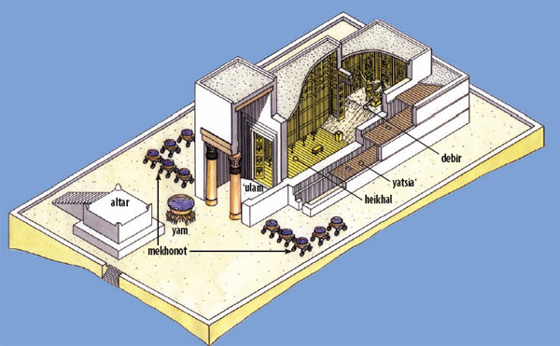
Solomon’s Temple
What did Solomon’s Temple look like? Although we have no physical remains, the Biblical descriptions offer many details, including the presence of an altar, a large bronze basin (yam) and ten wheeled carts, or mekhonot, in the courtyard in front of the building. The Temple itself was divided into three main portions: the ‘ulam, or porch, with two columns named Yachin and Boaz, the heikhal, or main hall or sanctuary, and the debir, or inner sanctuary (holy of holies). Around the outside were side chambers or a corridor, called the yatsia‘ in the Bible. The discoveries of other Iron Age temples from the Near East continue to shed light on Solomon’s Temple and its real-world context.
Biblical Archaeology Review 37:2, March/April 2011
Solomon’s Temple in Context

Slide 20
Cedars of Lebanon
1 Kings 5:8-9
So Hiram (king of Tyre) sent word to Solomon, saying, “I have heard the message which you have sent me; I will do what you desire concerning the cedar and cypress timber. “My servants will bring them down from Lebanon to the sea; and I will make them into rafts to go by sea to the place where you direct me, and I will have them broken up there, and you shall carry them away.”
This relief shows a fleet of Phoenician vessels, known as hippos ships, hauling timber by river from Lebanon to Khorsobad for construction of the palace of Sargon II, Assyrian king from 721 to 705 B.C.E. The ships are easily identifiable by their horsehead-shaped prows.
Biblical Archaeology Review 17:6, November/December 1991
The Sea Peoples and Their Contributions to Civilization

Slide 21
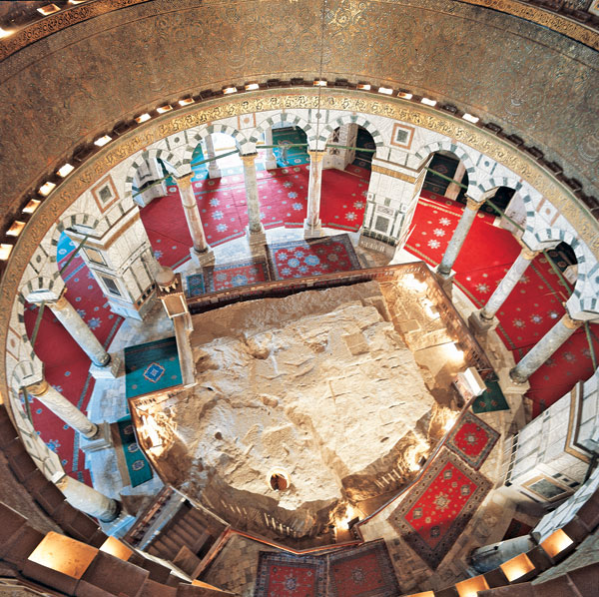
Foundation Stone of the Dome of the Rock
The highest point on the Temple Mount, the rock rises 5 feet above the floor of the Dome of the Rock. Steps lead to a cave below the rock, but the cave itself and access to it have been recut so many times over the centuries that it is impossible to know the original shape. According to early Muslim tradition, Solomon built his Temple directly over the rock. Later Muslim tradition identifies the rock as the place from which the Prophet Muhammad ascended to heaven.
Biblical Archaeology Review 32:4, July/August 2006
Islam on the Temple Mount

Slide 22
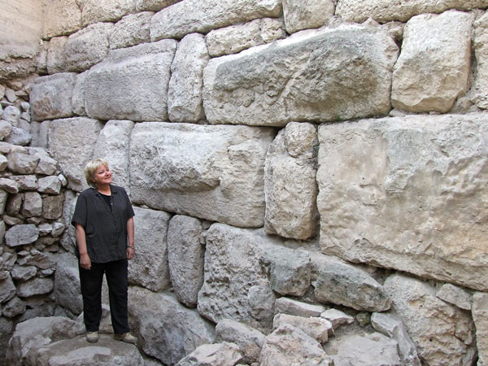
The Walls of Solomon
1 Kings 9:15
“This was the purpose of the forced labor which Solomon imposed: It was to build the House of the Lord, his own palace, the Millo, and the wall of Jerusalem, and to fortify Hazor, Megiddo, and Gezer.”
Professor Eilat Mazar is dwarfed by the massive blocks of the eastern wall of the Corner Turret she uncovered during her excavations south of the Temple Mount. Based on pottery found below the wall’s foundations, Mazar dates the fortification to the tenth century B.C.E., the time of King Solomon.
Biblical Archaeology Review 37:2, March/April 2011
Wall of Solomon’s Royal City Identified

Slide 23
Solomon’s Casemate Walls To Fortify Other Cities
A curving casemate wall gives an oval shape to the Aqrav fortress. In Solomon’s day, casemate walls were extensively used as fortifications. Casemate walls consist of two parallel walls interrupted at intervals by transverse walls that subdivide the area into rooms called casemates. One of those rooms is clearly seen in the right foreground of the photo. Casemate rooms could be used as armories, storerooms or lodgings, or they could be filled with rubble to strengthen the fortifications at the time of an attack.
Preserved to a height of over six feet, this casemate wall in the eastern side of the fortress surrounded a central unroofed courtyard. All of the Central Negev fortresses were protected by similar casemate walls.
Biblical Archaeology Review 11:3, May/June 1985
The Fortresses King Solomon Built to Protect His Southern Border

Slide 24
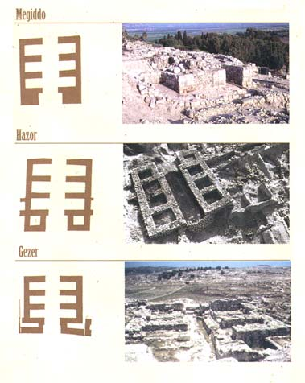
Matching Gates
The three gates have long stood as a dramatic example of how the Bible is proved right by archaeology. But the consensus over the gates is now under attack. Israel Finkelstein and David Ussishkin are re-excavating Megiddo, and they believe that the gate there is not Solomonic at all but rather dates to the ninth century B.C.—a good hundred years or so after Israel’s wise king. The debate over the dating of the gates occupied a special session at the [1998] academic conference of archaeologists and Bible scholars.
Biblical Archaeology Review 24:2, March/April 1998
Where Is the Tenth Century?

Slide 25
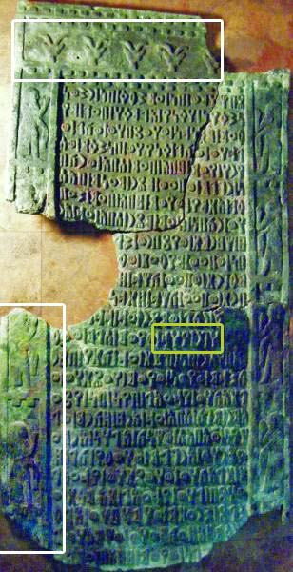
South Arabian Inscription Documenting Trade between Sheba and the "towns of Judah”
7th Century BC
This fragmented and broken but well-preserved 25-line South Arabian inscription mentions, among other things, a trading expedition of the kingdom of Sabaea (Biblical Sheba) to ’HGR YHD, the “towns of Judah.” Believed to date to around 600 B.C.E., the inscription confirms Judah’s role in a lucrative Arabian trade that is alluded to several times in the Bible.
“Towns of Judah”
Biblical Archaeology Review 36:1, January/February 2010
Solomon & Sheba, Inc.
Bible Review 11:1, February 1995
Altar-Ed States

Slide 26
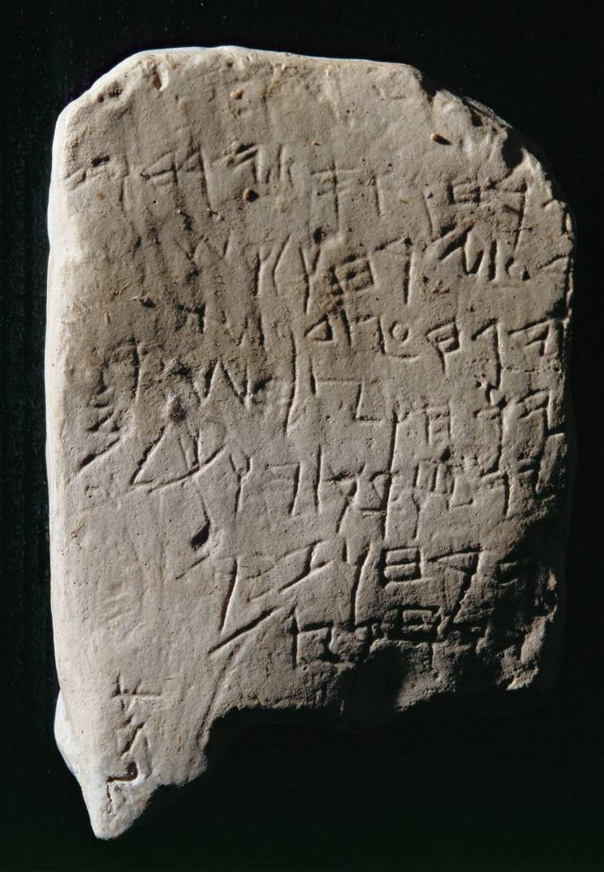
Gezer Calendar c. 10th Century BC
Gezer Calendar Inscription:
(1) His two months are (olive) harvest, his two months are
(2) grain planting; his two months are late planting;
(3) his month is hoeing up of flax;
(4) his month is barley harvest;
(5) his month is harvest and festivity;
(6) his two months are vine-tending;
(7) his month is summer-fruit.
Many scholars believed it was inscribed in Hebrew, but author Christopher Rollston hesitates in calling either the script or language Hebrew; the alternative is Phoenician.
Ecclesiastes 3:1-2
“For everything there is a season, and a time for every matter under heaven:
A time to be born, and a time to die;
A time to plant, and a time to pluck up what is planted;”
Biblical Archaeology Review 38:3, May/June 2012
What’s the Oldest Hebrew Inscription?

